Slide 1
California water fix South Delta Water Agency Parties Part 2 Rebuttal Testimony
TESTIMONY OF TOM BURKE

Slide 2
Opinions
The CWF H3+ scenario will have significant impacts on the salinity in the south and central delta.
The dsm2 model does not accurately reflect the existing channel geometry for significant portions of the south delta channels. That error in geometry will result in gravely erroneous results
The most recent version of the DSM2 model should be used in the CWF analysis and evaluation.
The existing NAA does not comply with the d-1641 requirements at the “Old River at Tracy” compliance point. With an expected increase in salinity for CWF H3+ , the inability to comply with D-1641 at this compliance point is exacerbated.

Slide 3
Opinions (Continued)
The project CFW H3+ scenario results in an increase in reverse flows for old and middle rivers.
The cwf h3+ scenario results in a significant reduction in water levels in Old and Middle Rivers. This reduction severely impacts areas of those channels that are already much shallower than predicted in the DSM2 model.
The DSM2 hydrodynamic model can be appropriately used to evaluate flow, stage, and water quality data on a time step as short as 15-minutes. Time steps shorter than 15 minutes were investigated by DWR, but they found that the 15-minute time step provided the best balance between accuracy and computational efficiency.
There is evidence to indicate that the Sacramento river may not be in temperature equilibrium with the air temperature. This could impact the delta downstream of the NDD’s.

Slide 4
Basis of Opinions
Based on Analysis Performed in Part 1 and Part 2
Conducted New Analyses on Existing Data.
Evaluated Petitioners Model Output For The CWF H3+ Scenario

Slide 5
Analysis
Evaluated the Change in Salinity from the CWF H3+ Scenario
Evaluated the Difference Between the Channel Geometry in DSM2 and the Actual Channel Geometry.
Use Of DSM2 To Predict Actual Values, Or Just Use in A Comparative Mode.

Slide 6
Analysis (continued)
Evaluated D-1641 Compliance in The South Delta
Evaluated The Increase in the Frequency of Reverse Flow in Old and Middle Rivers.
Evaluated the Change in Water Level In The South Delta For B1, B2, and CWF H3+

Slide 7
Analysis (Continued)
Evaluated the ability for the Sacramento River To Provide Cool Water To The Delta

Slide 8
Changes To Salinity From CWF H3+

Slide 9
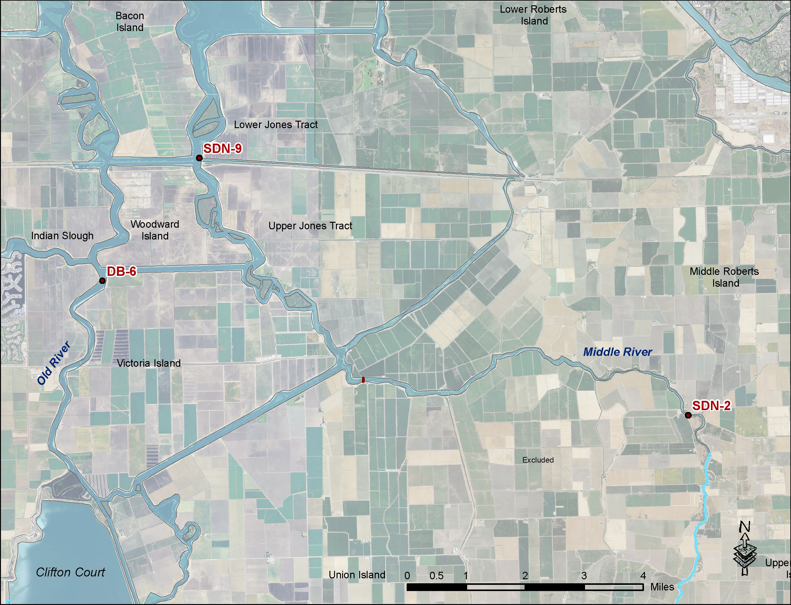
Central Delta Site Map

Slide 10
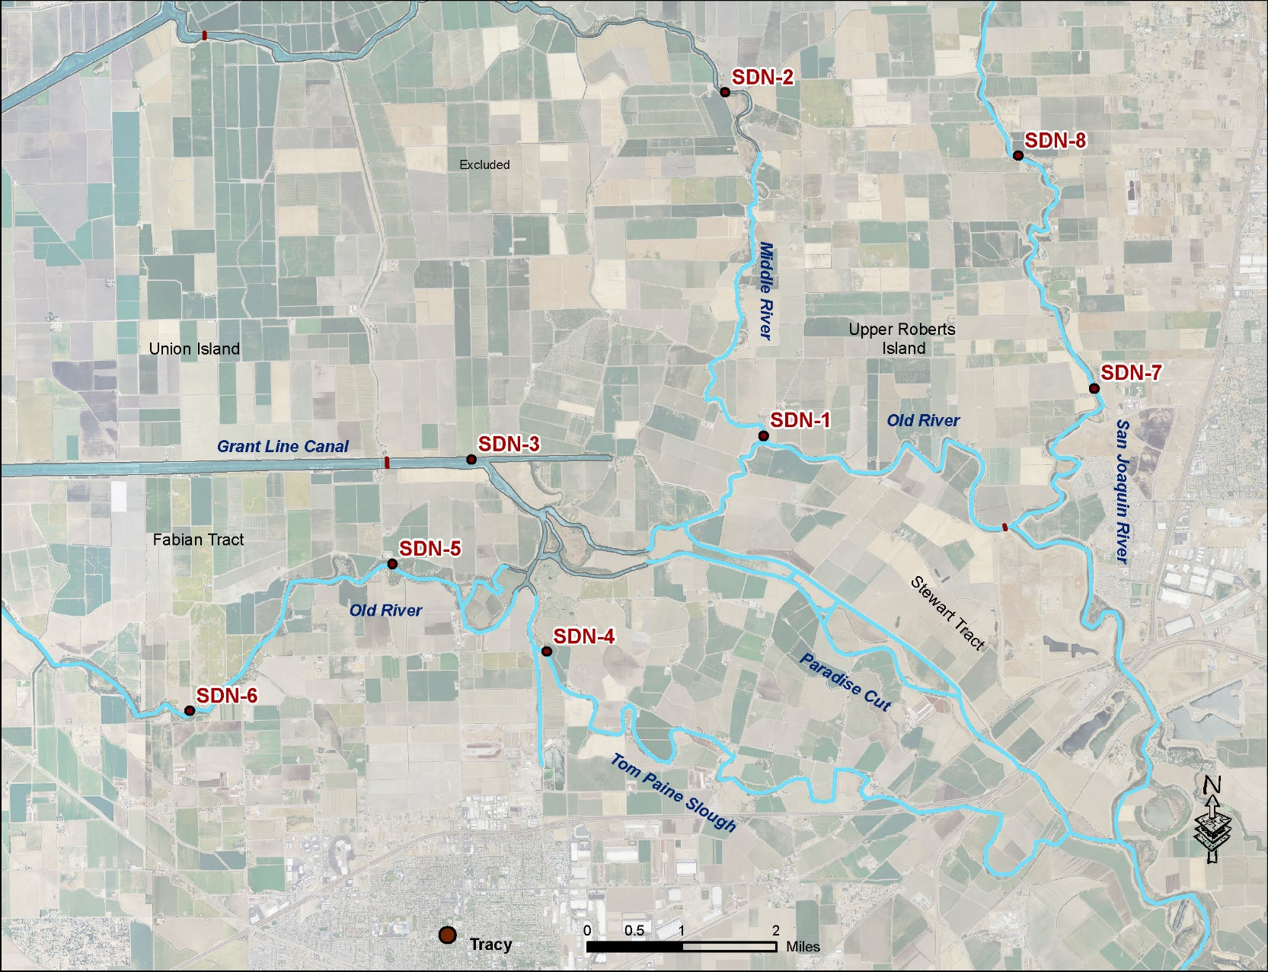
South Delta Site Map

Slide 11
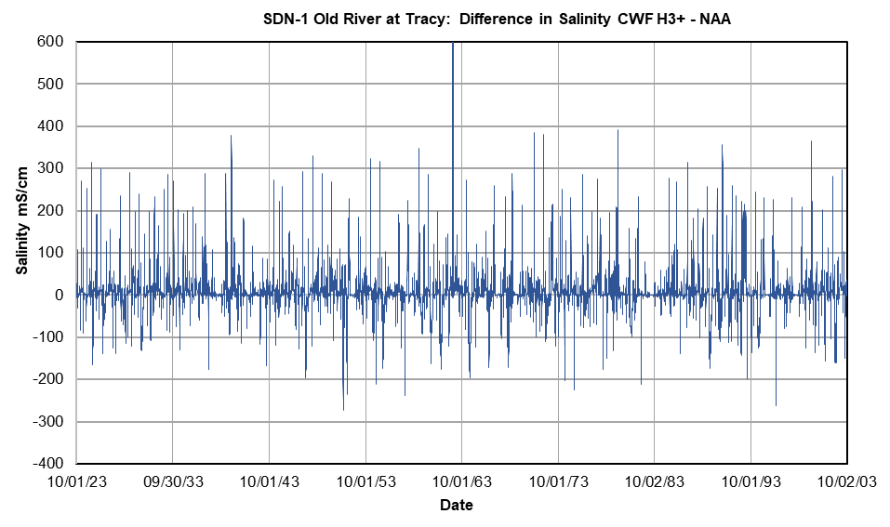
Old River - Salinity Change 1923-2003

Slide 12
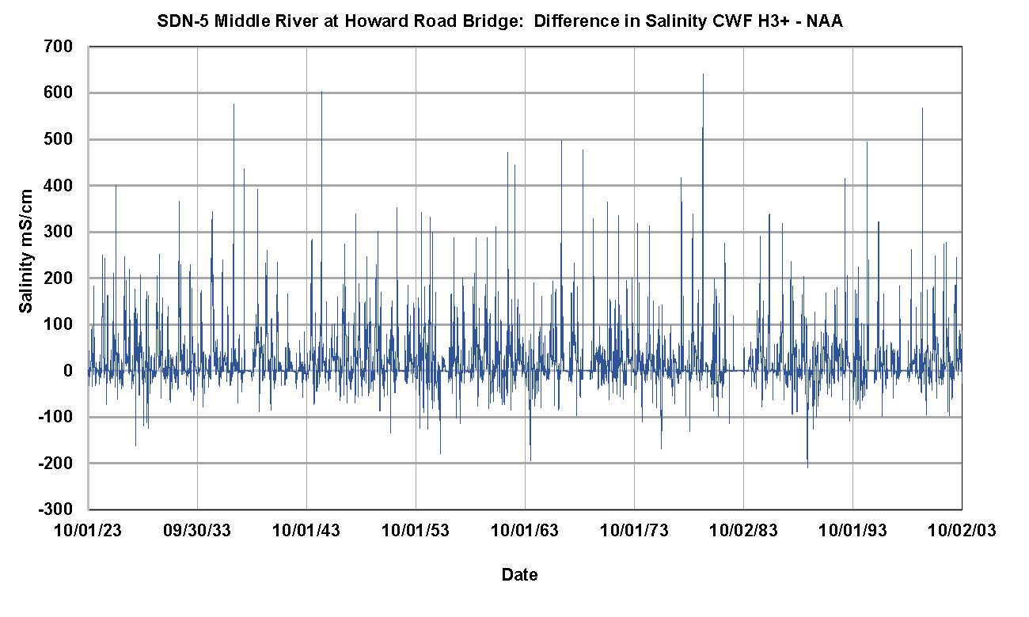
Middle River - Salinity Change 1923-2003

Slide 13
Old River - Critically Dry Water Year (1987)

Slide 14
Old River – Wet Water Year (1996)

Slide 15
Old River – Above Normal Water Year (1973)

Slide 16
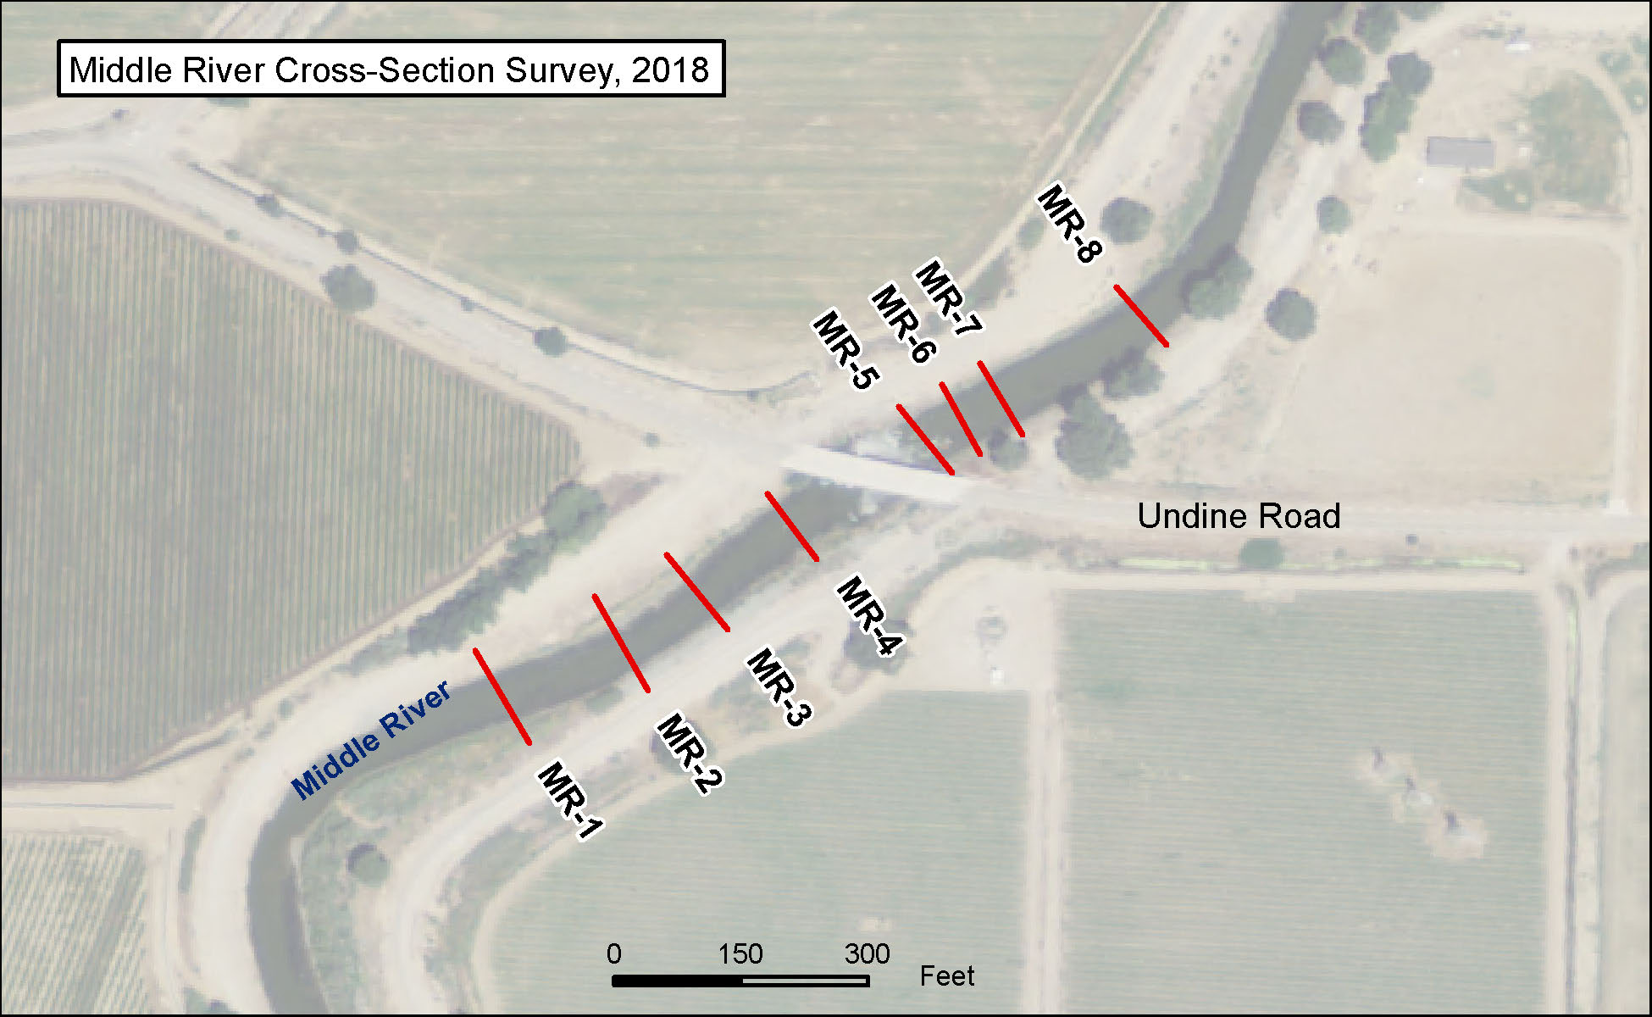
Evaluation Of Channel Geometry Differences Between DSM2 and Existing Channels

Slide 17
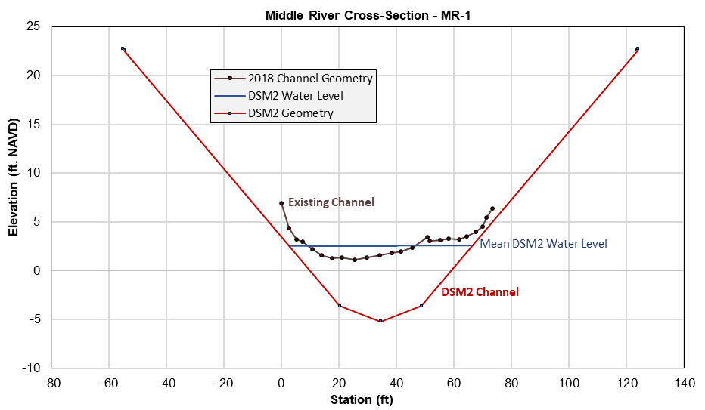
Middle River Cross-Sections

Slide 18
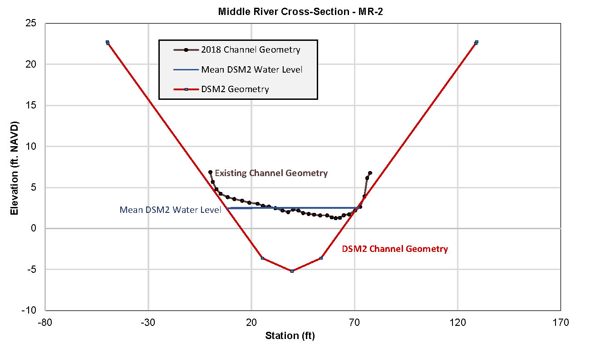
Middle River Cross-Sections

Slide 19
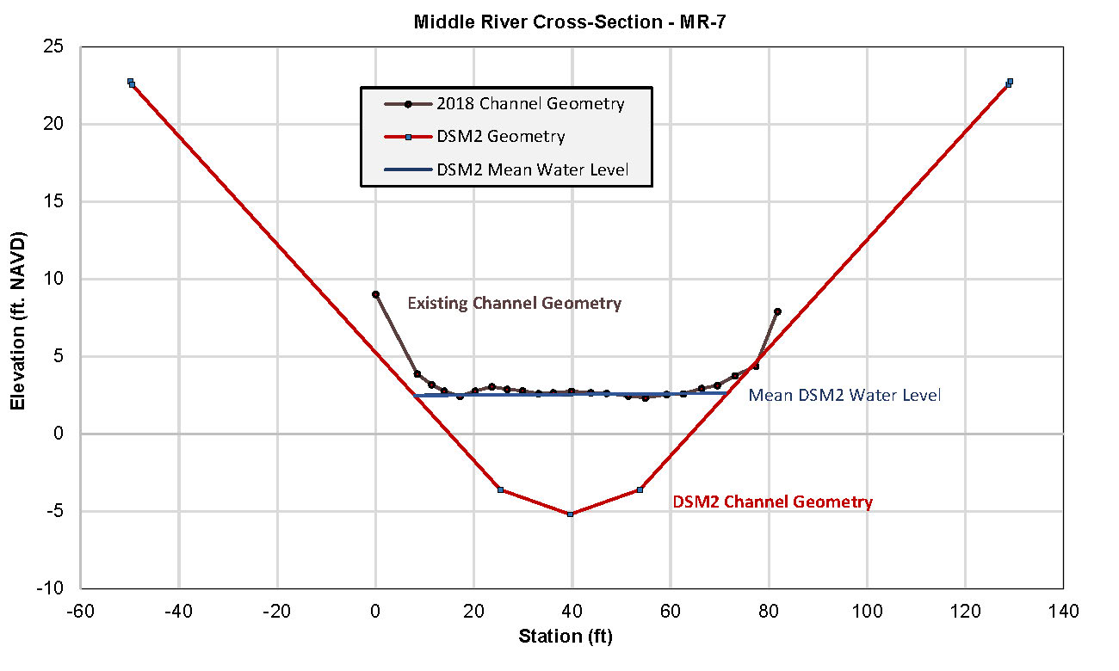
Middle River Cross-Sections

Slide 20
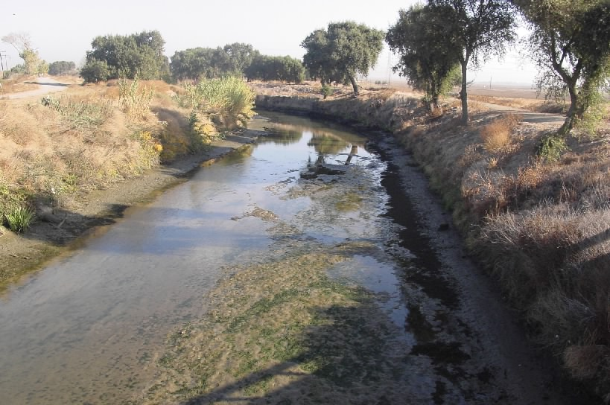
Middle River At Undine Bridge

Slide 21
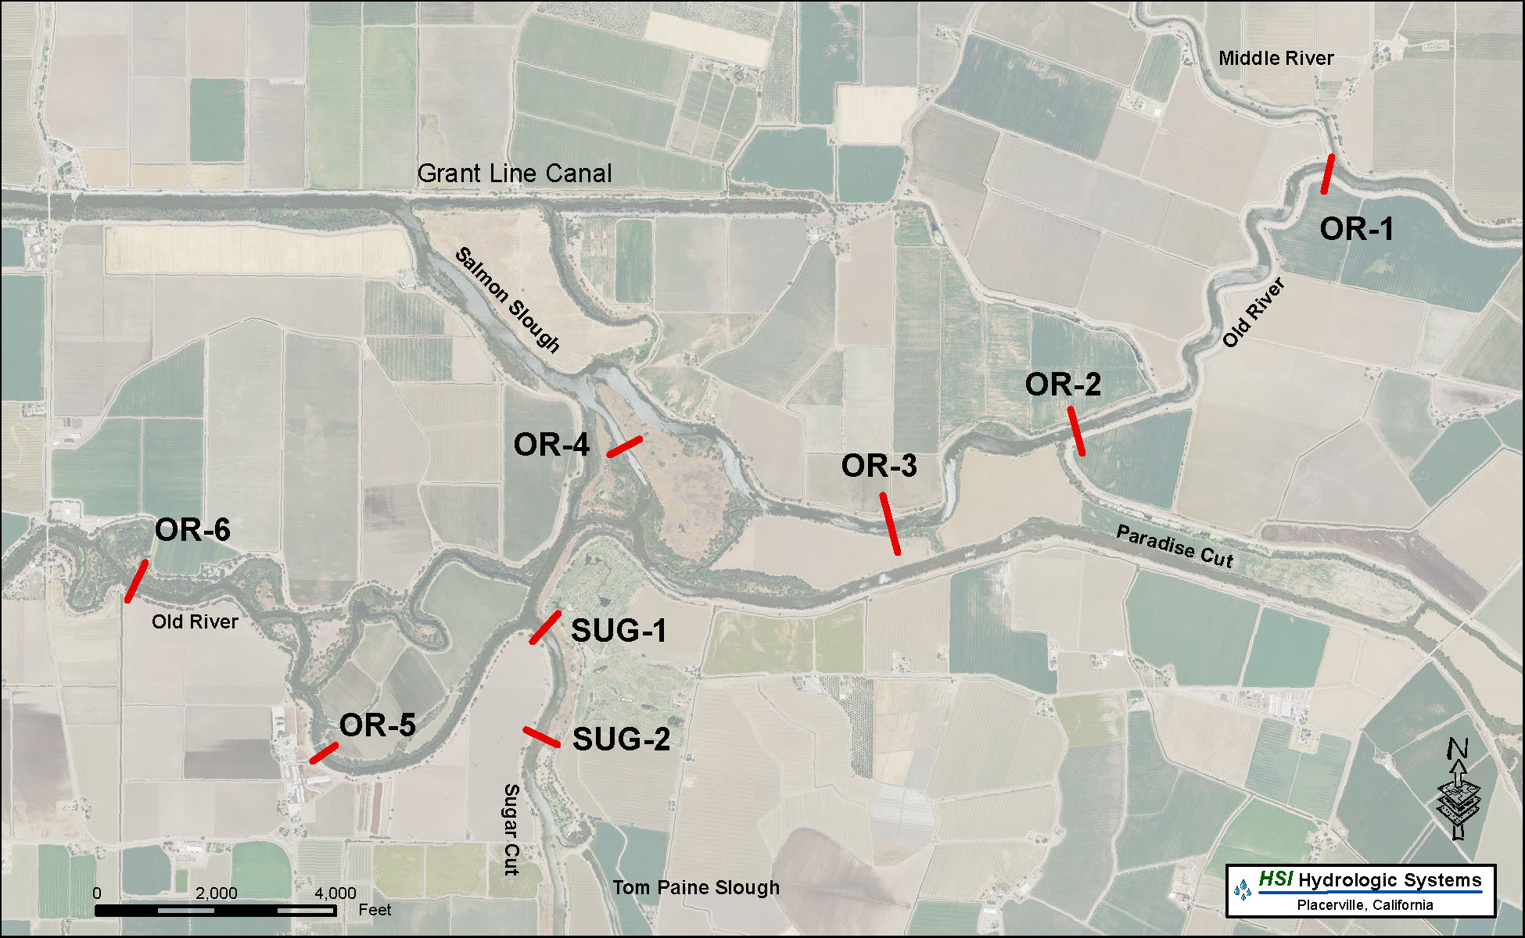
Old River Cross-Sections

Slide 22
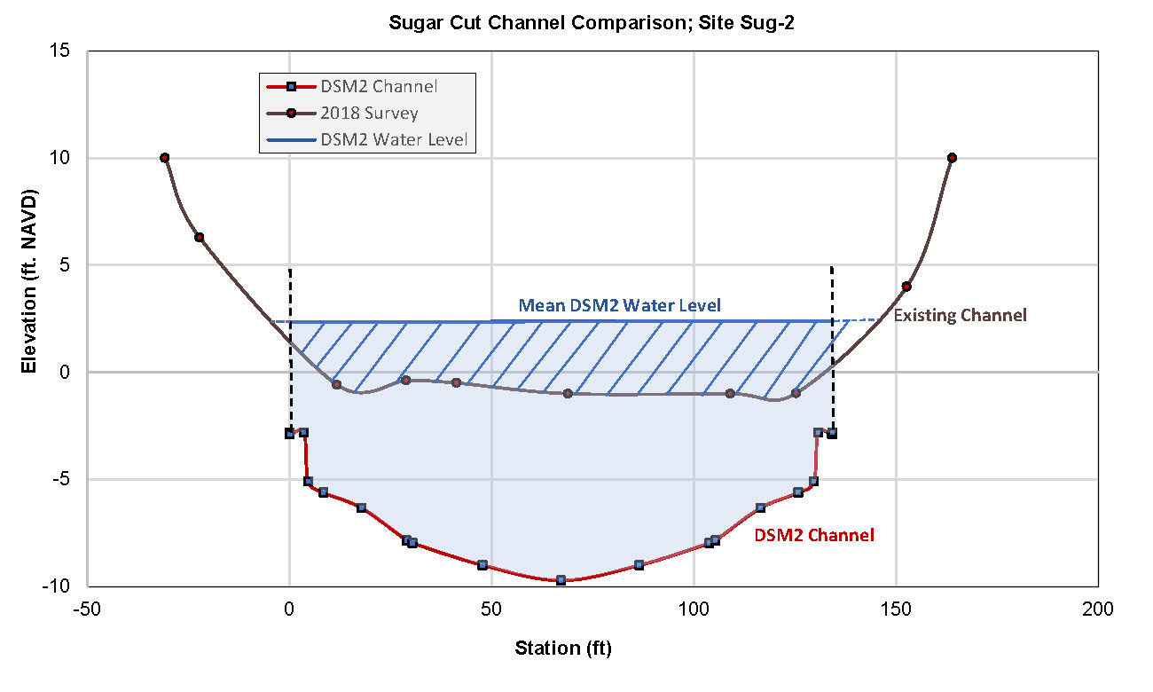
Old River Cross-Sections

Slide 23
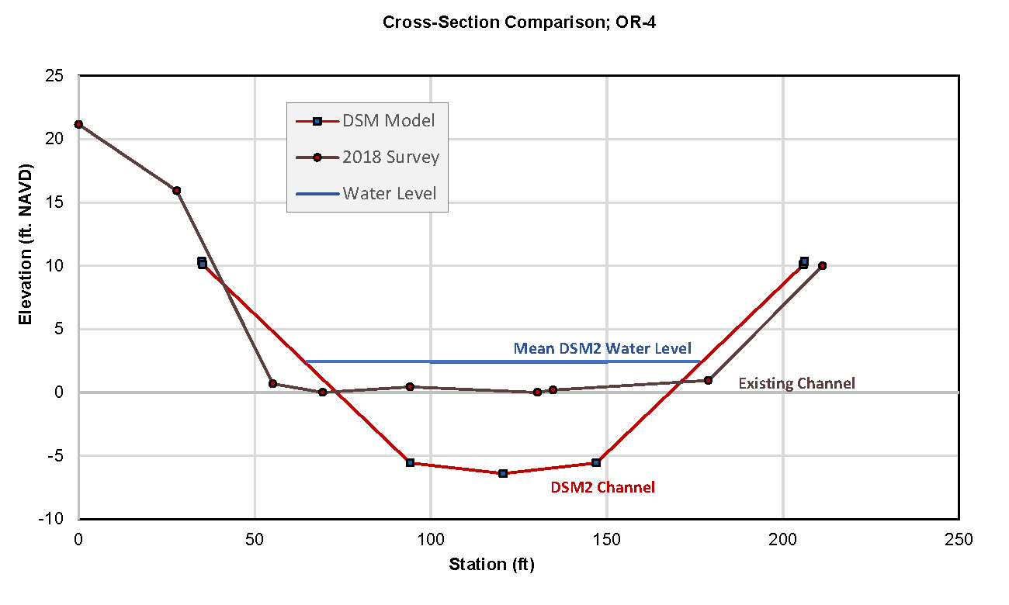
Old River Cross-Sections

Slide 24
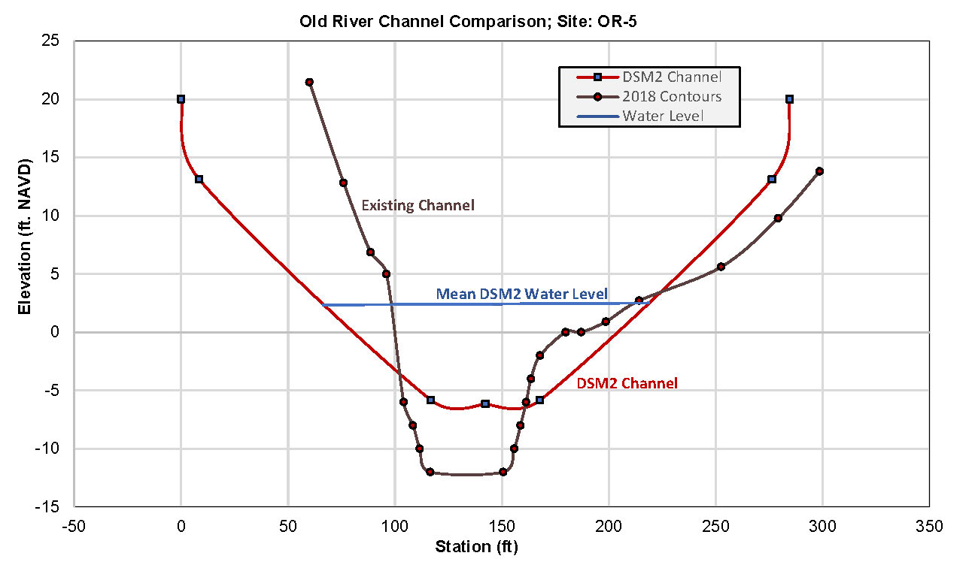
Old River Cross-Sections

Slide 25
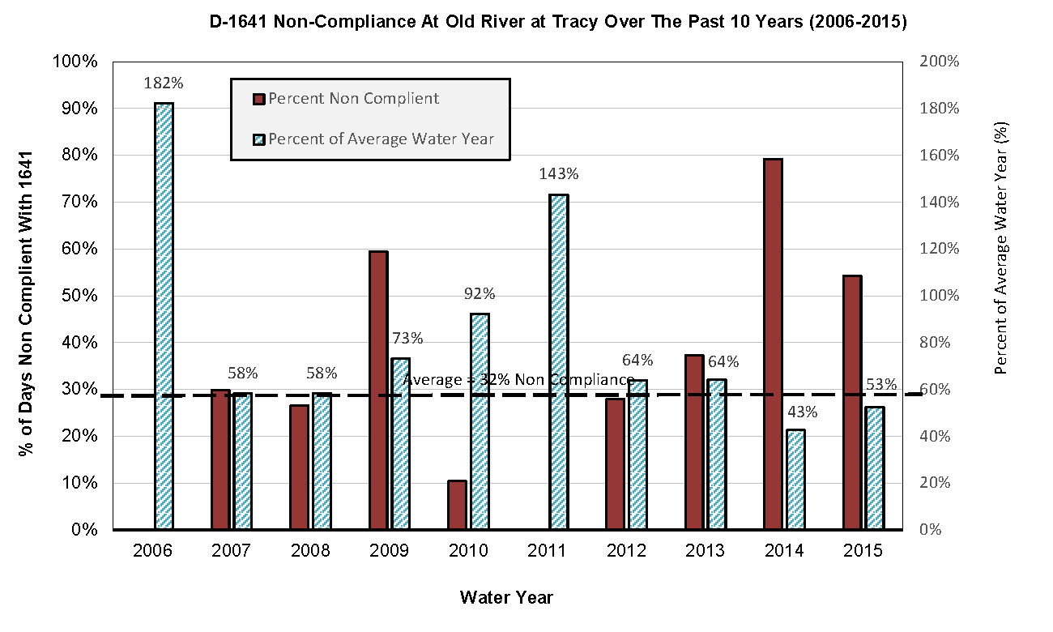
D-1641 Compliance

Slide 26
Sacramento River Temperature Assessment
Evaluated Data At Freeport Gaging Station
Flow Data
Water Temperature
Evaluated Air Temperature At Sacramento State University
Assessed The Potential For Equilibrium Conditions To Exist

Slide 27
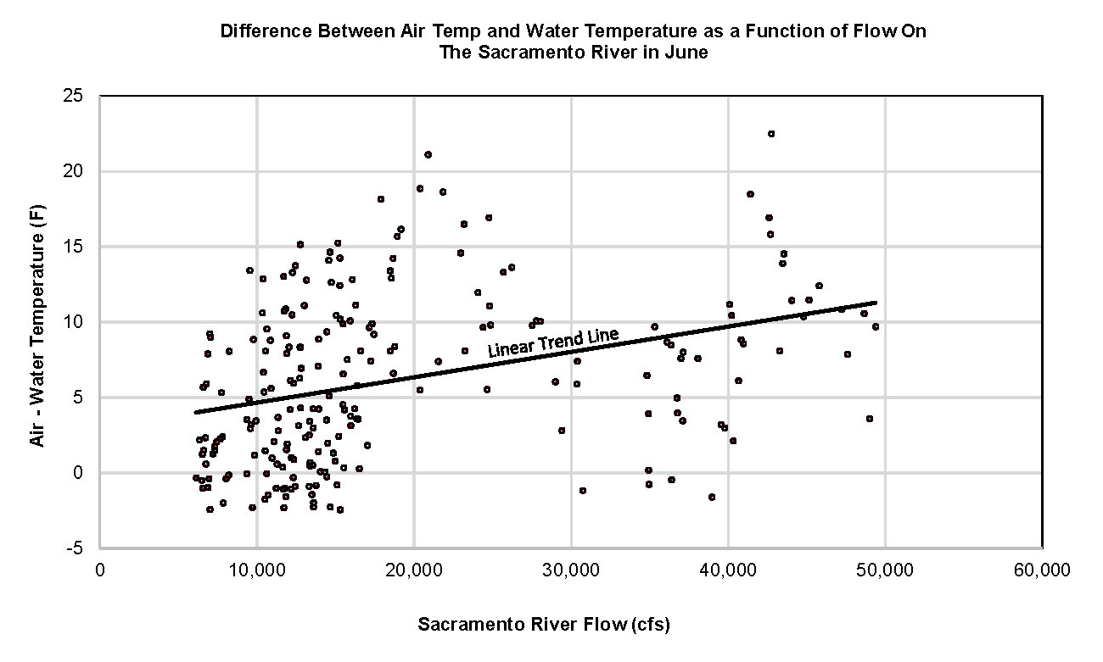
Air vs Water Temp - June

Slide 28
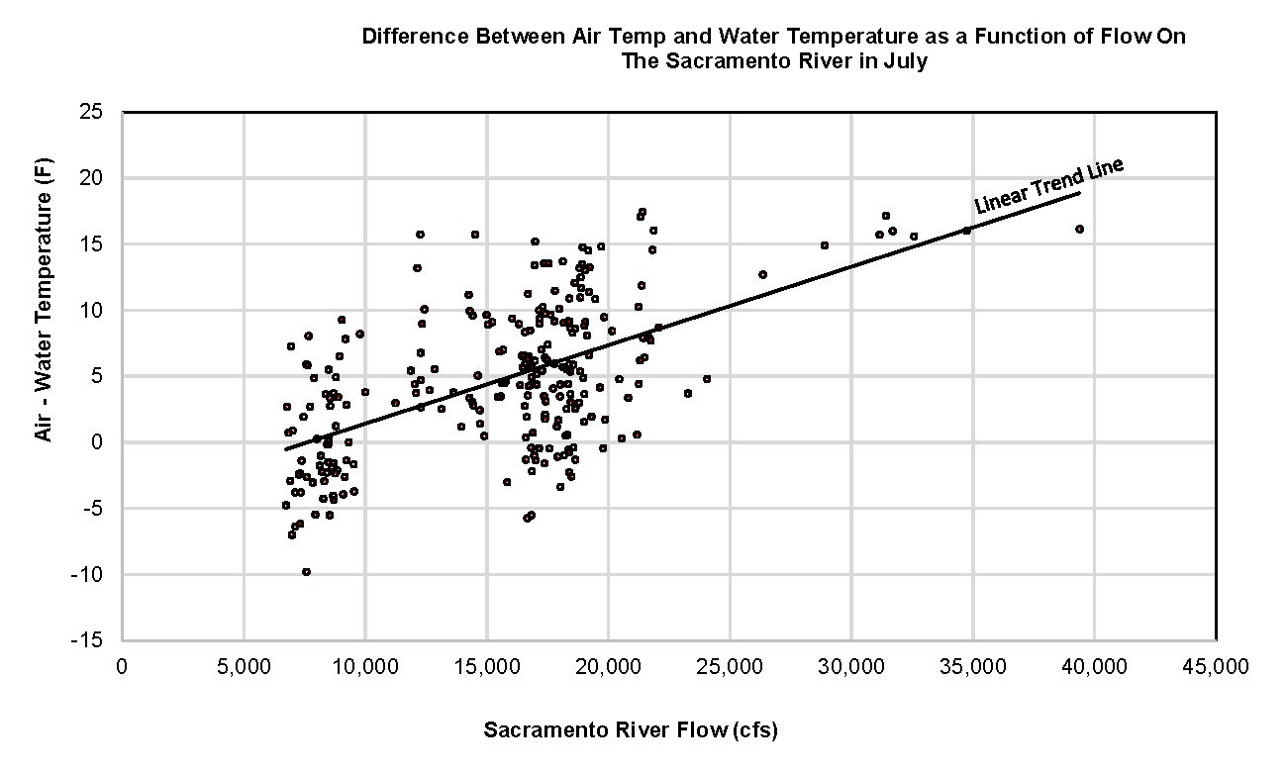
Air vs Water Temp - July

Slide 29
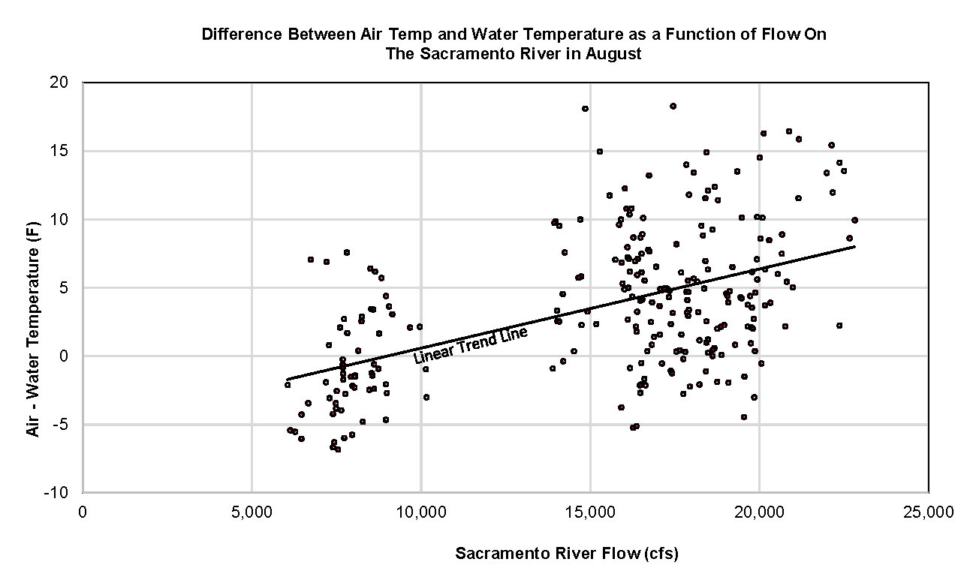
Air vs Water Temp - August

Slide 30
Conclusions
The CWF H3+ does not comply with the water quality objectives of D-1641 under CWF H3+, the project will be out of compliance more often, and to a greater degree.
The CWF H3+ will result in an increase in the number of reverse flows in Old and Middle River. Analysis of the petitioners DSM2 output shows a 22% increase in reverse flows on Old River at Tracy for the CWF H3+ over the NAA.
Based on the petitioners modeling, the CWF H3+ will result in an increase in salinity for all locations evaluated in the south delta, except for the Sn Joaquin River.
The DSM2 model has some very inaccurate representations of the channel geometry in the South Delta. The error in geometry is so bad in the middle river as to render any modeling results completely inaccurate.

Slide 31
Conclusions (Continued)
The CWF H3+ will result in significant reductions in water level in rivers in the South Delta. This reduction in water level can impact habitat, ability to irrigate, and water quality.
Using the DSM2 model to evaluate different scenarios on a 15-minute time step, is not only appropriate, but is using the DSM2 model the way it was designed to be used. This 15-minute data can be averaged over longer periods, but the longer the period that that you use to average the data, the more detail you lose in the model response.
The assumption that the Sacramento River is in thermal equilibrium with the air temperature may not be correct. Thus, removing this cooler water through the NDD’s may have downstream impacts.

